Slide 1
FeatureCAM 2007 Training
FeatureRECOGNITION

Slide 2
Agenda
Class Introduction
Feature Recognition (FR) Overview
What you get with FR
Importing 3D CAD
Import Wizard
Import Options
4 Methods of FR
Fully Automatic Feature Recognition
IFR Automatic
IFR From Surfaces
IFR Chaining
Holes in Detail
Milled Features in Detail
Rerecognition
Turning Recognition
Notes:
Class Introduction
Feature Recognition (FR) Overview
What you get with FR
Importing 3D CAD
Import Wizard
Import Options
4 Methods of FR
Fully Automatic Feature Recognition
IFR Automatic
IFR From Surfaces
IFR Chaining
Holes in Detail
Milled Features in Detail
Rerecognition
Turning Recognition

Slide 3
Feature Recognition Benefits
Ability to create features and NC code quickly, reducing programming time, saving you money.
Notes:
What is the benefit of feature recognition?
Ability to create features and NC code quickly, reducing programming time, saving you money.

Slide 4
What is a Feature?
Instead of Programming Parts One Operation at a Time, FeatureCAM Defines Parts With Features
-Common Shop Terms Such as a Hole, Groove, Pocket, Boss, Side or Face
-A Feature is made up of one or more associative operations
Notes:
What is a Feature?
Instead of Programming Parts One Operation at a Time, FeatureCAM Defines Parts With Features
These features are Common Shop Terms Such as a Hole, Groove, Pocket, Boss, Side or Face. That are made up of one or more associative operations.

Slide 5
Why is FR Necessary?
CAD data is just surfaces/faces
Holes in a solid are actually just cylinders
A pocket from CAD is actually just faces
FR Searches the CAD data to find FeatureCAM features
Will FR always be necessary?
Notes:
Why is FR Necessary?
CAD data is just a bunch of surfaces and faces
Holes in a solid are just cylinders
These faces, surfaces and cylinders need to be identified as features so machining operations may be applied to them.
How does FR work?
FR searches the CAD data (cylinders,surfaces, and faces) and matches them to FeatureCAM’s features.
Will FR always be necessary?

Slide 6
Manual Feature Creation Review
Create Geometry
Create Curves
Select Feature Type
Select Curve
Specify Depth
Enter manufacturing information
Obtain wireframe visual display
Obtain F/S, tools, toolpaths and NC code
Notes:
Create Geometry
Create Curves
Select Feature Type
Select Curve
Specify Depth
Enter manufacturing information
Obtain wireframe visual display
Obtain F/S, tools, toolpaths and NC code

Slide 7
Contrast Manual with FR
  MANUAL
Must create geometry -> curves, must specify depths, heights, etc.
Gives you more control, enables you to fine tune part for large lot sizes
  FR
Extracts geometry information from model
No need to recreate it
Is faster, better because fewer errors, cheaper from reduced programming time
Combination of manual and FR based upon individual requirements
Notes:
As shown previously you must create geometry then curves, specify feature type then specify heights and depths.
The advantage of creating features manually is that we have more control over feature creation enabling us to fine tune parts for large lot sizes.
The disadvantage of creating features manually is that it is time consuming and you are recreating CAD info that is already available.
Feature Recognition extracts this CAD info from the model
This is faster and superior to manual Feature creation as it results in fewer user errors and reduced programming time.
Many parts are programmed using a combination of both Manually and FR recognized features.

Slide 8
Discussion Points
Popularity of CAD and solids
Why recreate work that has already been done?
Difference of solid vs. surface model
Pros/cons solid vs. surface
Healing and Stitching
FR features same as manual features
The perfect answer?
Notes:
The drafting table has become obsolete to shops, and the use of CAD and solid modeling packages has become more popular than ever due to it’s capability to make changes rapidly.
Why recreate work that has already been done? The data is already there so we should USE IT!
FR options are the same whether you are using manual recognition or AFR.
Discussion Point:
Teaser… The perfect answer is: one button manufacturing
Invite class to discuss why the perfect answer is difficult to achieve
Each machinist/machine/shop/part has different: manufacturing capabilities, fixturing methods, tolerance requirements, rigidity characteristics, stock characteristics, shop resources,

Slide 9
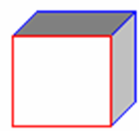
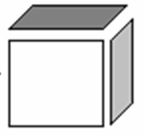
What is needed for FR?
Solid or a surface

Slide 10



What is the difference?
Notes:
What is the difference between a solid and surface? A Solid can hold water it has volume. A surface is basically a sheet of paper.
What is easier to model a box with a solid or surface? Answer: a solid because you don’t have to make six sides.
One of the benefits of solids is that they are they are easy to modify because they are parametrically modeled. If you created box using solids and wanted to change the height of the box in FeatureCAM all you have to do is change one dimension, if you wanted to change this using a box created with surfaces you would need to change the dimensions on all four side surfaces, then translate the top surface to the top of the top of the modified sides.
Can you change a
Solid to a surface? Answer: Yes, always by exploding the solid into surface
Surface to a solid? Answer: Yes, only if the surfaces contain a closed volume

Slide 11
Import
Paper space import of DWG/DXF files
We keep up-to-date on all of our file formats

Slide 12
What are the formats supported?
3D import with FeatureRECOGNITION
  IGS (IGES 3D)
  SAT, SAB (ACIS)
  X_T, XMT (Parasolid)
  SLDPRT, SLDASM (SolidWorks)
  IPT, IAM (Inventor)
  PAR, ASM (SolidEdge)

Slide 13
Optional Import Plug Ins
Catia V4
Catia V5
STEP
Unigraphics
Pro/E
Notes:
The Above are Plug ins that are available for FeatureCam that will allow you to import additional file types.

Slide 14
What You Get with FR
Ability to import 3D file formats
Ability to extract curves from 3D models
Curve from surface constructors
Features are: holes, slots, bosses, pockets, sides, face
Direct hole import from SolidWorks, Inventor
AFR capability (a button/menu item)
A checkbox for IFR in the New Feature Wizard
A rerecognition capability (a button/menu item)
Notes:
Feature Recognition is it’s own module that may be purchased seperatley.
It includes the curve wizard that has the ability to extract curves from a solid
This module enables you to Import Solids but not do solid modeling. Solid Modelling is another package.
AFR is included with FR a useful tool that will extract all curves,holes, features ect.. In the click of a button.
The option to use IFR with a checkbox when using new feature wizard.

Slide 15
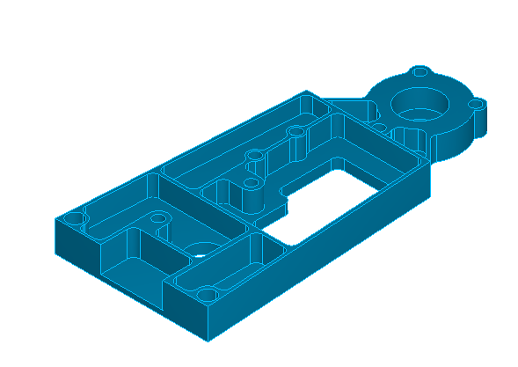
Demonstrations
How to import
The Import Wizard
Import Options
Notes:
Many ways to import a file in FC:
Ways to open a file in Featurecam
File>Open
File>Import
Drag and drop
Shading works, try it
How are units handled?
Import wizard Assists in Importing the file into FeatureCAM
When you import a file, FeatureCAM steps you through its import wizard. This wizard helps you:
Import the file into FeatureCAM
Size the stock
Orient the stock
Position the part program zero
Set up a milling part for indexing
For some solid file formats, it even helps you recognize and suppress some part features
To run the wizard, select Import from the File menu and follow the steps of the wizard.
Examples\FeatureRECOGNITION\ex02ex02.sat
AfrDemo.x_t is unitless, and will be silly if you import into an inch document
Note setup and UCS are GONE – replaced with coordinate in lower left
Size and shape of stock
Orient the stock in Z and X – features must be aligned with Z
Position the part program zero
Indexing control
For some solid file formats, it even helps you recognize and suppress some part features
You can skip the wizard entirely if you wish(for clamps, or other control)
You can transform the part yourself if you wish

Slide 16
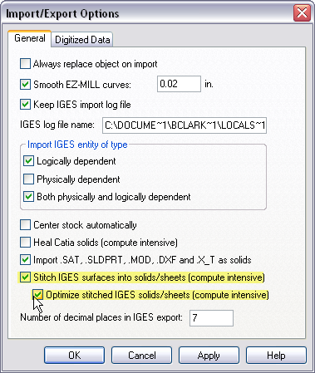
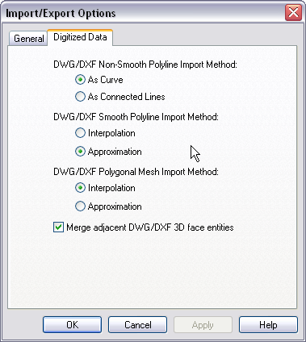

Import/Export Options
Notes:
Talk about the following on the slide:
General tab
Read the help file ahead of time to make sure you know what these options are. Not all of them are important anymore.
Digitized Data tab
This is for importing CMM-type data from a specific Bridgeport mill. We used to have a strong tie with Bridgeport and that’s why this is in here.
General Import/Export Options:
Set these options to control how FeatureCAM imports or exports files.
Always replace object on import when checked, overwrites objects of the same name when you import. Unchecked prompts for every replacement. You can’t have two objects with the same name
Smooth EZ-MILL curves sets how to improve EZ-MILL curves on import as FeatureMILL has a higher resolution curve format.
Keep IGES import log file sets whether to keep a log of the import process for later review or troubleshooting.
IGES log: Show Example\FeatureRECOGNITION\12951528.igs
Review IGES log displays the log file (in Notepad) after importing a file.
IGES log file name sets the path and filename for saving a record of the import process.
Physically dependent - Generally, this checkbox should be unchecked to indicate that you do not want physically dependent entities to be imported. But if you are having trouble with your IGES file and it isn't importing properly, then try checking this checkbox and reimporting. Entities in an IGES file are marked to be either physically dependent or not. Those that are marked to be physically dependent are entities that are used in the construction of other entities. For example, a trimming loop is physically dependent upon the trimmed surface that uses it. The trimming loop isn't important all by itself, but is instead a building block of something else. The trimmed surface will in turn be marked physically dependent to indicate that it is a building block of a parent entity, a solid. By turning on Physically Dependent, you will be causing FeatureCAM to show everything in the IGES file -- not just the top-level entities that are usually shown, but also all of the lower-level building blocks. This is generally not what you want. Generally you want only the top-level entity, for example the solid. But if you are having trouble importing, then consider turning on "physically dependent".
Logically dependent can exist by itself but is also referenced by another entity (case of groups or grouping situation
Both physically and logically dependent meets both logically and physically dependent criteria (is referenced by at least two other entities the parent for the logical link can not be the parent for the physical as well.
Number of decimal places in IGES export determines how finely data is exported to the IGES format.
Center stock automatically will alter the stock to automatically size and position itself so that it covers the imported data. See also Resizing the stock.
Heal .MOD solid will try and repair the faces or surfaces contained in the CATIA .MOD file. This option can be time consuming since it attempts to:
retrim the surfaces/faces against each other
force edges of a surfaces actually lie on the surface
simplify surfaces like converting a general surface into a cylinder.
Import .SAT .SLDPRT, .MOD, .DXF and .X_T as solids will import these files as solid models. If this option is turned off, the models are imported as surface models. It is recommended that you import these models as solids. If this option is enabled and the solid fails to import properly, you are asked if you would like to attempt to heal the solid to try and fix the import problem.
More about Importing IGES files into FeatureMILL .
Stitch IGES surfaces into solids/sheets will attempt to create one or more solids or sheets from an IGES file. If an IGES file contains more than one solid or sheet, this is the most efficient way to create the multiple objects from the file. If you want to create a solid from an IGES file, it is generally recommended to also check the option, Optimize stitched IGES solids/sheets. This option is compute intensive and will attempt to recompute sloppy intersections between surfaces.
Digitized data import/export options:
Digitized data is imported into FeatureMILL through DXF POLYLINE entities. The Digitized data import/export options affect how this data is imported. These settings only affect the import of the data. If you want to change one of these options, you must remove the old data and import the DXF file again.
Non-smooth Polyline Import
If a non-smooth polyline is imported it is imported as a curve if As curve is checked. If As connected lines is checked, the polyline is imported as a series of line segments.
Smooth Polyline Import
If the POLYLINE is has smooth vertices, it is imported as a curve. The DXF Smooth Polyline Import Method has two settings:
Interpolation: The curve will pass through the data. If the data is very dense, interpolation will sometimes cause the curve to wiggle in between the points. The spline interpolation technique is used to create the curve.
Approximation: The curve will come very close to the data points and is unlikely to wiggle for densely spaced data.
Polygonal Mesh Import
If the POLYLINE is a polygonal mesh it is imported as a surface. The DXF Polygonal Mesh Import Method has two settings:
Interpolation: The surface will pass through all of the data points. If the data is very dense, some wiggles may appear in the surface. A cubic hermite technique is used to create the surface.
Approximation: The surface will come close to the data points. The points are used as control points to the surface and the surface is unlikely to wiggle for densely spaced data.

Slide 17
4 Methods of Feature Recognition
Four different techniques
Fully automatic – “AFR”
IFR Automatic (by feature type)
IFR using surfaces or faces
IFR chaining
Notes:
Four different techniques
Fully automatic – “AFR”
IFR Automatic (by feature type)
IFR using surfaces or faces
IFR chaining

Slide 18
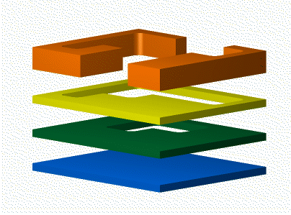
Automatic Feature Recognition (AFR)
Overview
Ideal situations
Limitations
Usage
Notes:
Automatic Feature Recognition recognizes all of the features of a model at once. It creates plain, counter drilled, counter bored and counter sunk holes and all milling features are created as side features. It will often create a set of features that will completely cut your solid, but it may create more features that you might create if you modeled the features yourself.

Slide 19
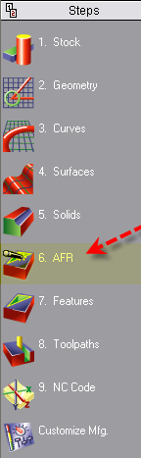
AFR Overview
Attempts to make all features, all at once
Horizontal slices
For true 2D parts, will cut complete part
Plain, counter drilled, counter bored and counter sunk holes
All milling features are created as side features
Notes:
Automatic feature recognition wizard - The automatic feature recognition (AFR) wizard attempts to create all features for milling a part. It creates features by dividing the model into horizontal slices. All features of the model are recognized at once. It creates plain, counter drilled, counter bored and counter sunk holes and all milling features are created as side features. It will often create a set of features that will completely cut your solid, but it may create more features than you might create if you modeled the features yourself.

Slide 20

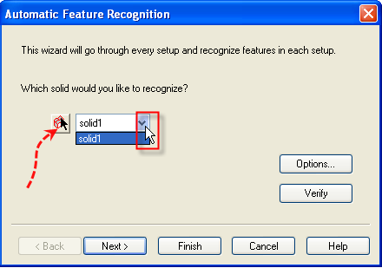
Using AFR
Import your solid
Click the AFR toolbar
Select your solid from the pulldown menu or use the the pick Icon and select the solid in the FeatureCAM window

Slide 21
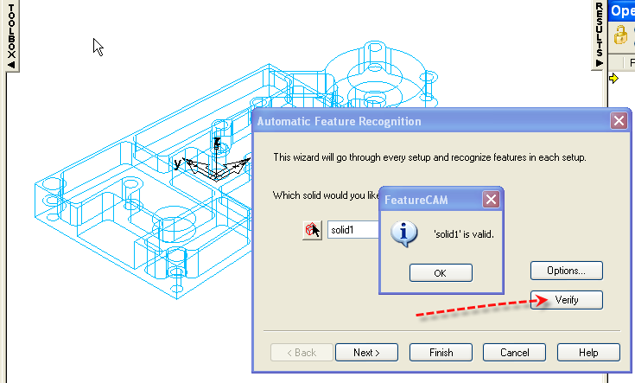
AFR Verify Solid
Notes:
If you have any doubts about the validity of the solid you are working with, click the Verify button. It will run a series of checks on the solid and tell you if it checks out.

Slide 22
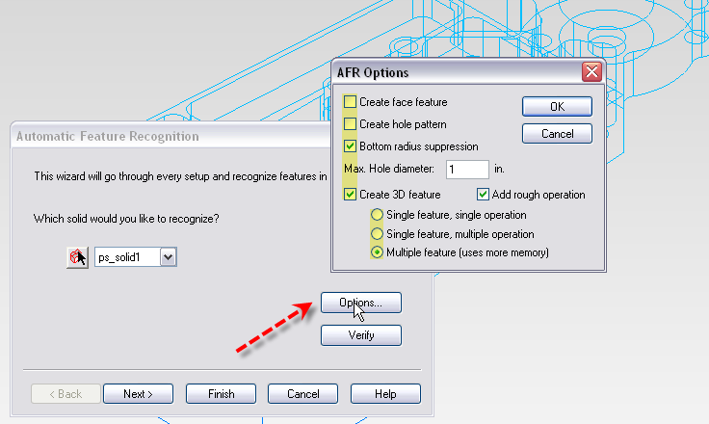
AFR Window

Slide 23
AFR Options
Select Solid
Create a face feature
Create a hole pattern
Bottom radius suppression
Max Hole Diameter
Create 3D Feature
Single Feature, Single Operation
Single Feature, Multiple Operation
Multiple Feature, Uses more memory
Notes:
Click the Options button to view the various options available for feature recognition.
Select: the name of the solid from the drop down menu, or click the Pick solid button and pick the solid in the graphics window.
Face: If you want to create a face feature to automatically level the top of the part, click Create face feature.
Hole: If you want to group holes into patterns, click Create hole pattern.
Bottom: radius suppression will ignore the radius at the the bottom of a pocket
Max Hole Dia: The max hole diameter is threshold between holes and pockets. For cylinders larger than this value, a side feature will be created instead of a hole.
Single Feature, Single Operation: Lumps everything together
Single Feature Multiple Operation: One Feature with
Multiple Feature:

Slide 24
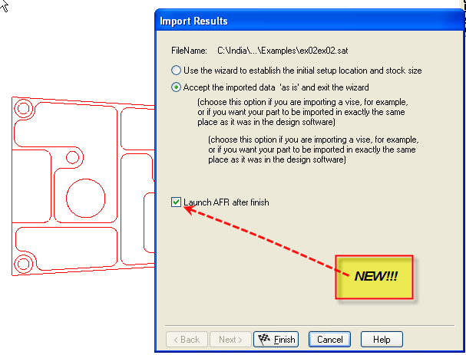
AFR Example
Examples\2.5D ex02ex02.sat
Import the above file and set units to mm.
Accept the imported data as is.
Check the Launch AFR after finish or use the AFR toolbar.
Notes:
Examples\ 2.5D ex02ex02.sat
Import the above file and set units to mm.
Accept the imported data as is
Check the Launch AFR after finish box or use the AFR toolbar
Check the make a pattern of holes option (show the results).
Open a new file and show without pattern of holes checked (compare the part views).

Slide 25
AFR Examples Cont.
ImportExamples:\2.5DTutor9.sat
ImportExamples:\2.5D AFR 2 Setups.x_t
ImportExamples:\2.5D pocket with open groove.fm
ImportExamples:\ 2.5D 3 AFR_IFR setups.sat
ImportExamples:\ 2.5D hex boss.sat
ImportExamples:\ 2.5D simple plate sharp end corner.sat
Notes:
AFR Examples
Examples\FeatureRECOGNITION\2.5D ex02ex02.sat
Examples\Tutorials\3D MODELS\2.5D Tutor9.sat
2.5D AFR 2 Setups.x_t illustrates how we can handle features on the side, also multiple setups
Import the file 2.5D AFR 2 Setups.x_t in mm. accept as is Resize the stock if necessary. Next Create a new setup and align to stock face \back\ UR corner
and Finish.Select AFR and pick the solid then Finish. Run 3D sim for this 2 times Once with the Stock\Properties\Indexing checked as setup dominant and once as tool dominant.
Import the file 2.5D pocket with open groove.fm use AFR and run sim then go to a front view and click on each side feature in the Part view window and the slices will highlight in red.
Mmill2.fm? show some limitations – it has corner rounds
2.5D simple plate sharp end corner.sat illustrates sharp corners
2.5D 3 AFR_IFR setups.sat is interesting, has multiple setups, plus it illustrates cutting air and the need to delete a feature from setup2
2.5D hex boss.sat, 2.5D simple plate sharp end corner.sat is easy

Slide 26
AFR Ideal Situations
Quick programming of prototypes
Analysis of the part, preparation for programming
Cost estimating, preparing bid for customer
Can be used as starting point, and in combination with other methods

Slide 27
AFR Limitations
Requires a solid model
Won’t make same features that you would make
Some features are cut in slices
Won’t be most efficient in machine time
Notes:
Automatic feature recognition (AFR) can only be performed on solid models.
If you do not have a solid model, you can either stitch the surfaces into a solid or use another method of feature recognition.

Slide 28
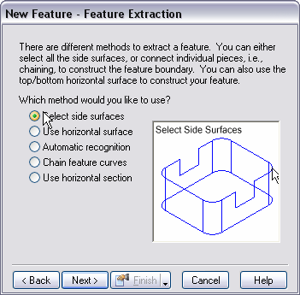
IFR
(Interactive Feature Recognition)
The methods we can select are:
  Select side surfaces
  Use horizontal surface
  Automatic recognition
  Chain feature curves
  Use horizontal section
Notes:
IFR stands for interactive Feature Recognition
There are different methods to extract a feature using interactive feature recognition.
The methods we can select are:
1) Select side surfaces
2) Use horizontal surface
3) Automatic recognition
4) Chain feature curves
5) Use horizontal section

Slide 29
IFR Automatic
Overview
Limitations
Usage
Notes:
Examples
Find all the holes, pockets, etc. in the following files
Examples\FeatureRECOGNITION\ex02ex02.sat
Examples\Tutorials\3D MODELS\Tutor9.sat
We need an example for IFR Automatic for a boss

Slide 30
IFR Automatic Overview
Can be nearly as quick as AFR
Uses different techniques than AFR that can create features like you would have made them
Recognize one kind of feature at a time
Finds all such features
Supports holes, pockets, bosses, sides
Notes:
Use checkbox in New Feature Wizard
Use the “Automatic recognition” radio button

Slide 31
IFR Demonstrations
Examples\FeatureRECOGNITION\2.5D ex02ex02.sat
Examples\Tutorials\3D MODELS\Tutor9.sat

Slide 32
IFR Automatic Limitations
Requires solid model
Not quite as fast as AFR

Slide 33
IFR From Surfaces/Faces
Overview
Limitations
Usage
Notes:
Overview
Select Side Surfaces
Trick: hide non verticals, then top view, then region select
Pocket notes when using “select side surfaces”
Trick: pockets need to be closed, so take top view and look for a loop
Islands aren’t supported – you need to add them later
Tapered/drafts with cylindrical corners aren’t supported
Chamfers aren’t supported, but you can edit dimensions
Multiple pockets can be done at once, but will be milled one z-level at a time
IFR From Surfaces/Faces
Use horizontal surface
Pockets from bottom surfaces
Bosses from top surfaces
Solid not required
Secret: you can give a vertical surface to specify heights/depths. It won’t affect the shape.
Limitations
Usage
Use checkbox in new feature wizard
Use appropriate radio button too
Face
Select a face, then use IFR
Works with faces or surfaces
Works best on solids -- other faces are avoided
If you use surfaces, they do not avoid other surfaces
Examples
Prof face.fm
Face
Select a face, then use IFR
Works with faces or surfaces
Works best on solids -- other faces are avoided
If you use surfaces, they do not avoid other surfaces
Examples
Prof face.fm
Overview
Select Side Surfaces
Trick: hide non verticals, then top view, then region select
Pocket notes when using “select side surfaces”
Trick: pockets need to be closed, so take top view and look for a loop
Islands aren’t supported – you need to add them later
Tapered/drafts with cylindrical corners aren’t supported
Chamfers aren’t supported, but you can edit dimensions
Multiple pockets can be done at once, but will be milled one z-level at a time

Slide 34
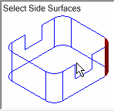
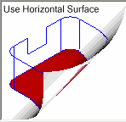
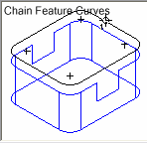
IFR From Surfaces/Faces
Select side surfaces
Select horizontal surfaces
Chain Feature curves
Notes:
Overview
Select Side Surfaces
Trick: hide non verticals, then top view, then region select
Pocket notes when using “select side surfaces”
Trick: pockets need to be closed, so take top view and look for a loop
Islands aren’t supported – you need to add them later
Tapered/drafts with cylindrical corners aren’t supported
Chamfers aren’t supported, but you can edit dimensions
Multiple pockets can be done at once, but will be milled one z-level at a time
IFR From Surfaces/Faces
Use horizontal surface
Pockets from bottom surfaces
Bosses from top surfaces
Solid not required
Secret: you can give a vertical surface to specify heights/depths. It won’t affect the shape.
Limitations
Usage
Use checkbox in new feature wizard
Use appropriate radio button too
Face
Select a face, then use IFR
Works with faces or surfaces
Works best on solids -- other faces are avoided
If you use surfaces, they do not avoid other surfaces
Examples
Prof face.fm

Slide 35
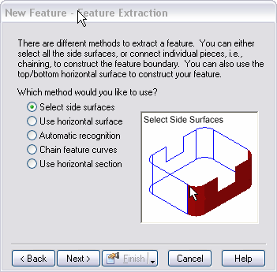
IFR From Surface Overview
Select side surfaces
Select horizontal surfaces
Notes:
IFR From Surfaces/Faces
Use horizontal surface
Pockets from bottom surfaces
Bosses from top surfaces
Solid not required
Secret: you can give a vertical surface to specify heights/depths. It won’t affect the shape.
Limitations
Usage
Use checkbox in new feature wizard
Use appropriate radio button too

Slide 36
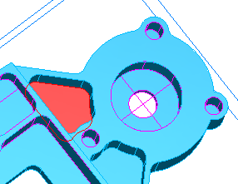
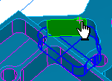

IFR From Surface Demonstrations
Top
Bottom
Notes:
This method extracts the shapes from the bottom surface, you must interactively pick the top and bottom of the features.
Also show “Use side surfaces”.
Tip: picking one wall surface will supply values for the top and bottom fields.
Repeat using Side surfaces

Slide 37
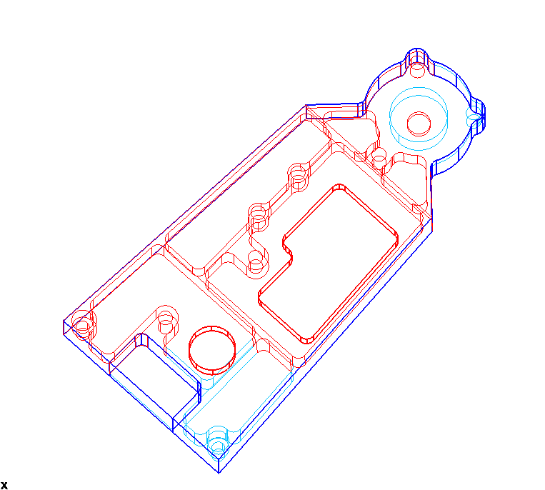
IFR Chaining
Overview
Limitations
Usage
Notes:
IFR Chaining
Overview
For milled features, pockets, bosses and sides, no holes
Projects to ucs for chaining
Vertical or tapered surfaces
Good for features with too many surfaces to pick
Solid not required
Remove hidden lines for back features
Switch to top view or not
Pick pieces or closed curve choices
Keeping geometry – see the curve wizard
Top & bottom page for depth and starting Z

Slide 38
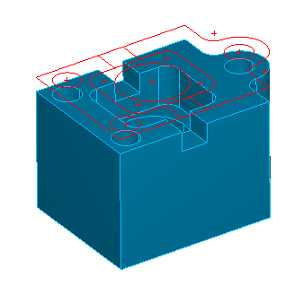
IFR Chaining
Geometry is created and chained by projecting along linear “vertical” surfaces
Only way to recognize drafted features
Requires the most interaction
Notes:
Tip: This method (or curve from surface projection method) can be used to extract geometry from a solid model.

Slide 39
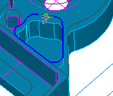
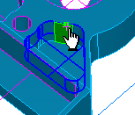
IFR Chaining Example
Click the Feature Step
Choose the Feature Type
Click Next and click from Chain Feature Curves, click Next
Chain the curve above the pocket
Click the top and bottom points
Notes:
This curve makes a 2D projection of the vertical surfaces and allows you to create the shapes you want using chaining. It provides you with the most control of all of the methods.

Slide 40
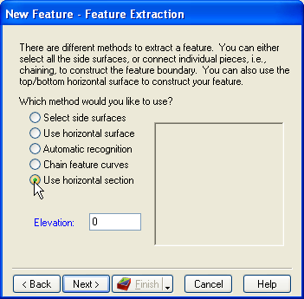
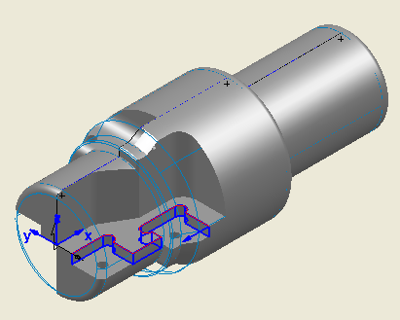
Slice Chaining for IFR
Notes:
Open “Turnmill cutter horizontal slide.fm”
Go to Isometric view
Shade
Hide stock
Rotate so you can see feature. Point to the feature.
Create new side feature using feature wizard and make sure “extract with FeatureRECOGNITION” is checked.

Slide 41
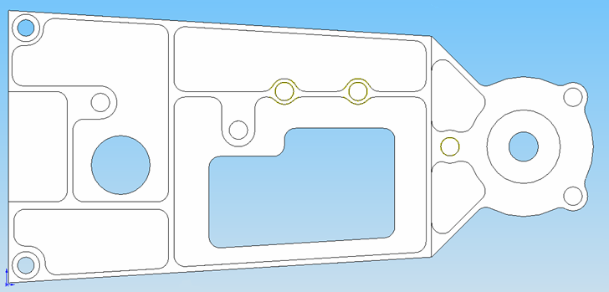
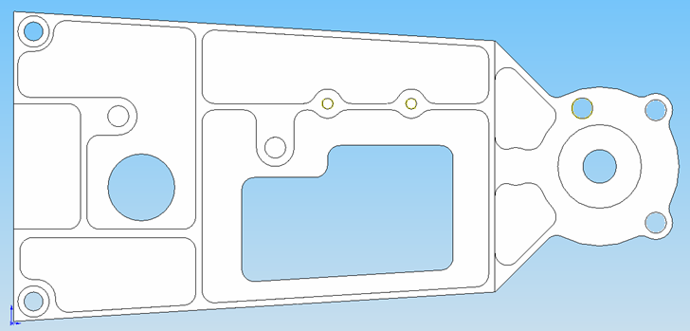
Recognition and Rerecognition
Launch AFR after import wizard
Reimport with same transformation
Rerecognition for hole patterns
Original Part
Revised Part
Notes:
This next example will show 3 things:
1) Launch AFR after the import
2) Reimport modified part with same transformation
3) Rerecognition for hole patterns
The part on the left is our original part and the part on the right is the revised part. One hole moved and changed to through holes. Two holes diameter modified
“File” -> “open” 2.5D Rerecognition.x_t and 2.5D Rerecognition2.x_t .xlt

Slide 42
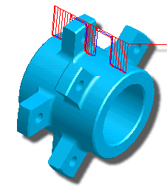
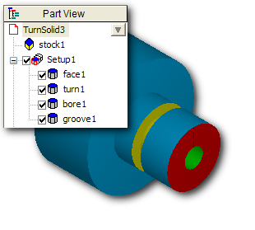
Turning Recognition
Good at extracting profile curves from solid
Functionality is still fairly basic
Curve-based techniques fairly powerful
Notes:
Turnmill 8 tabs with holes chain feat curves.x_t

Slide 43
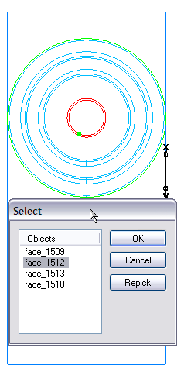
Turn FR Example
Turning 3 diameters with hole.x_t
Answer No in Align Part
Click pick surface button and end surface
Click Reverse Direction and click Next
Click Yes in Resize

Slide 44
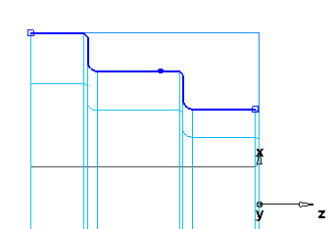
Turn Feature Recognition Example
Click Yes and Solid Method
Do not click Recognize turn/groove features
Chain the blue curve using open curve chaining with three clicks
Create a turned feature
3
2
1

Slide 45
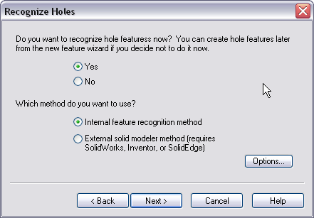
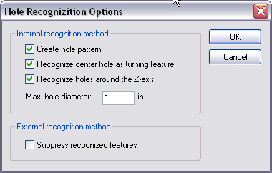
Turn Import Wizard Enhancements
Automatic hole recognition
SolidWorks wizard hole recognition
Notes:
Turnmill IFR holes auto.SLDPRT

Slide 46
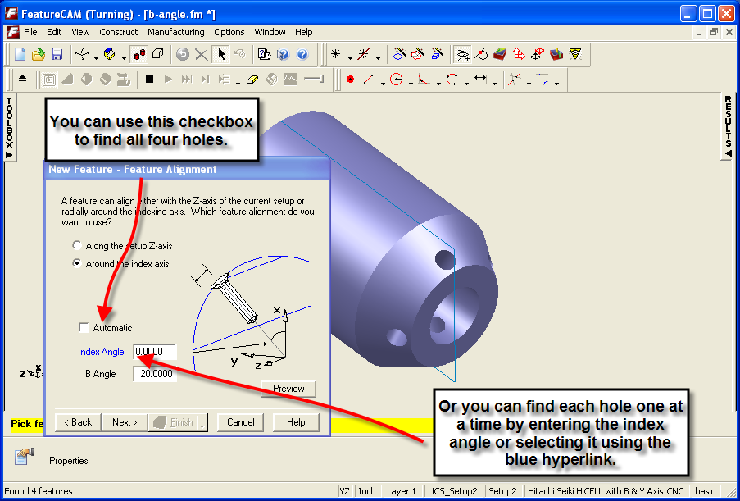
B Angle Support
Notes:
Turnmill pockets with b axis.x_t

Slide 47
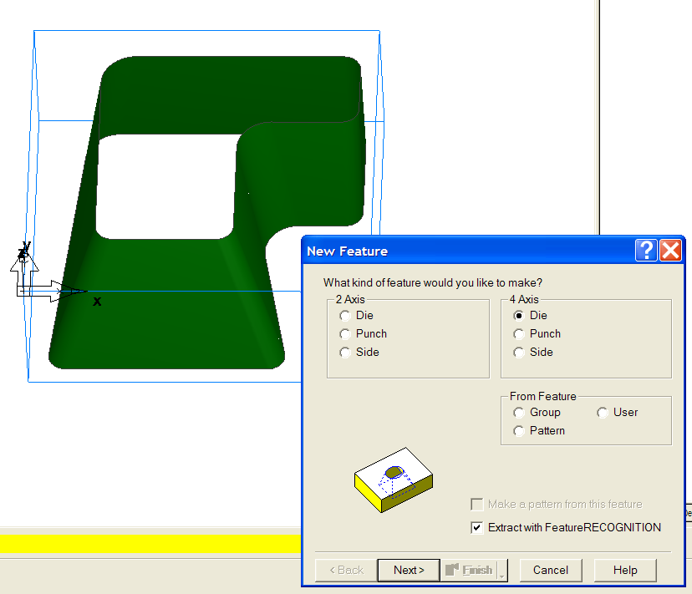
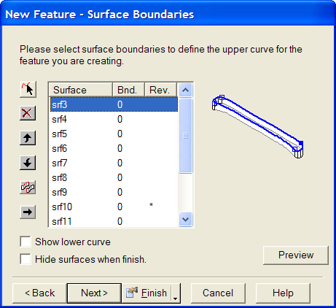
Wire EDM Enhancements
4-axis feature from ruled surface
Notes:
wire4xIFR.fm (for untrimmed surface only)

Slide 48
Feature Recognition
4 axis wire EDM
Uses a method similar to Surface Edges

Slide 49
Feature Recognition
Interactive FR improvements for turn/mill and milling
B-axis hole recognition
Custom hole recognition
Solidworks hole pattern support
Rerecognititon of hole patterns for SW
Solidedge direct hole import
Wire EDM
Others

Slide 50
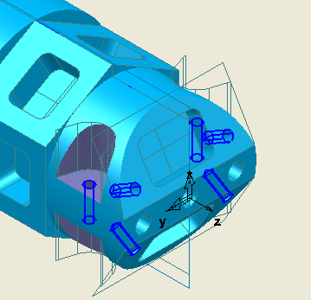
Feature Recognition
B-axis hole recognition
This sample part along with a tutorial is available in our training materials on our distributor site

Slide 51
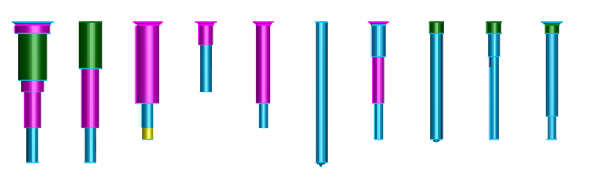
Feature Recognition
Custom hole AFR
Using UDFs
UDF author specifics a set of cylinders to match
Notes:
For automotive ports
For mold-base ports
Some customers define hundreds of holes

Slide 52
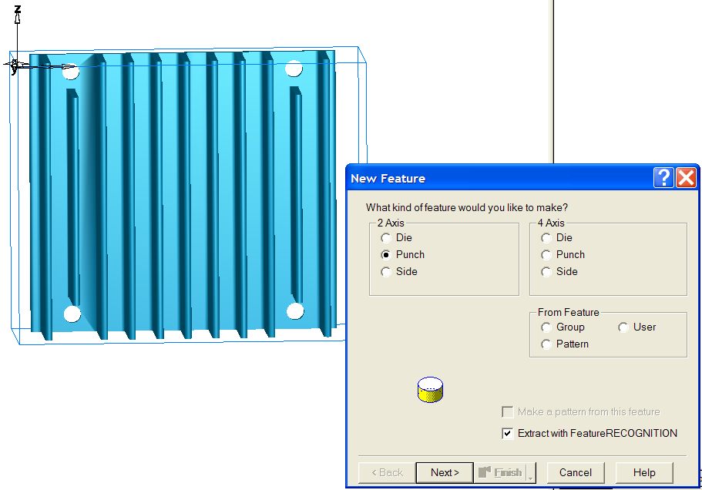
Feature Recognition
2 axis wire EDM
Uses familiar projection/chaining idea

Slide 53
Feature Recognition
4 axis wire EDM
Uses a method similar to Surface Edges

Slide 54
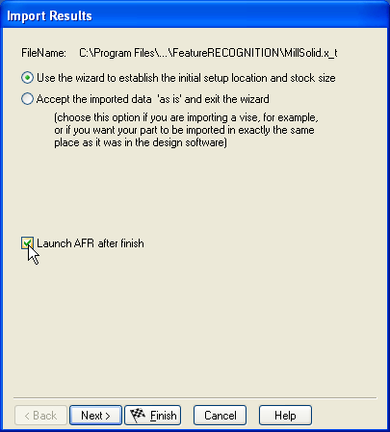
Feature Recognition
Remember the import transform for rerecognition
Launch AFR after import

Slide 55
Course Review

